Slide 1

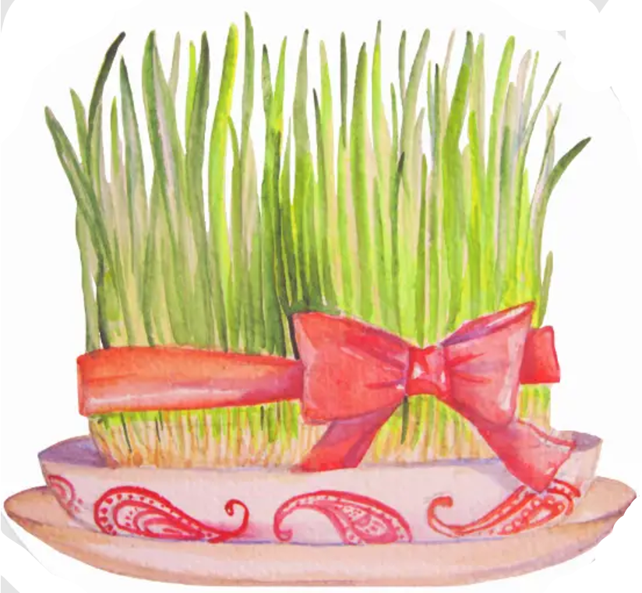
Nowruz
Run up to Nowruz
Preparing for Nowruz starts a few weeks prior to the New Year with a traditional spring cleaning of the home
At this time it is also customary to purchase new clothing and new furniture for the family, and help the less fortunate others

Slide 2
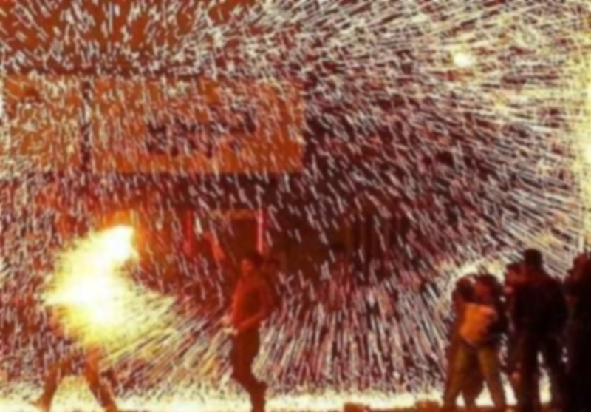
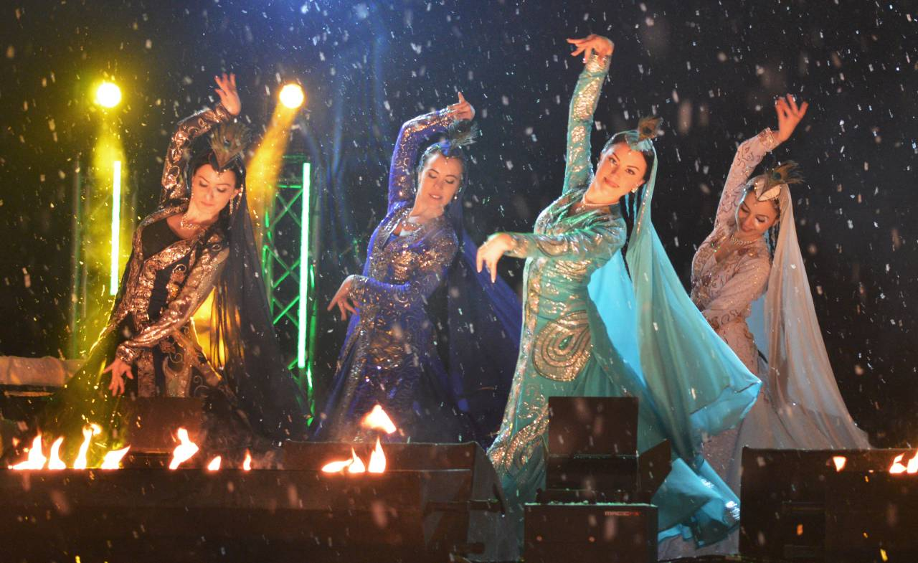
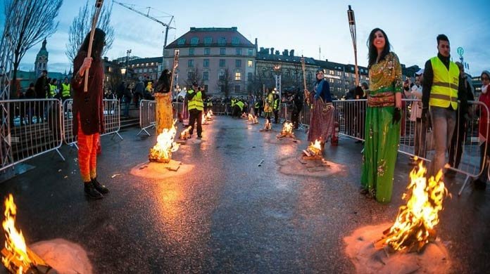
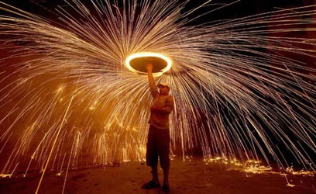
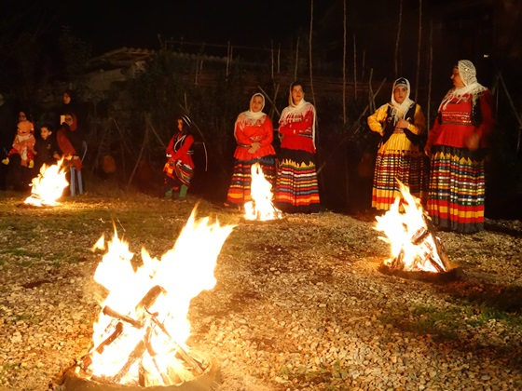
Chahärshanbe-Süri (in Persian)
Nowruz
Run up to Nowruz

Slide 3
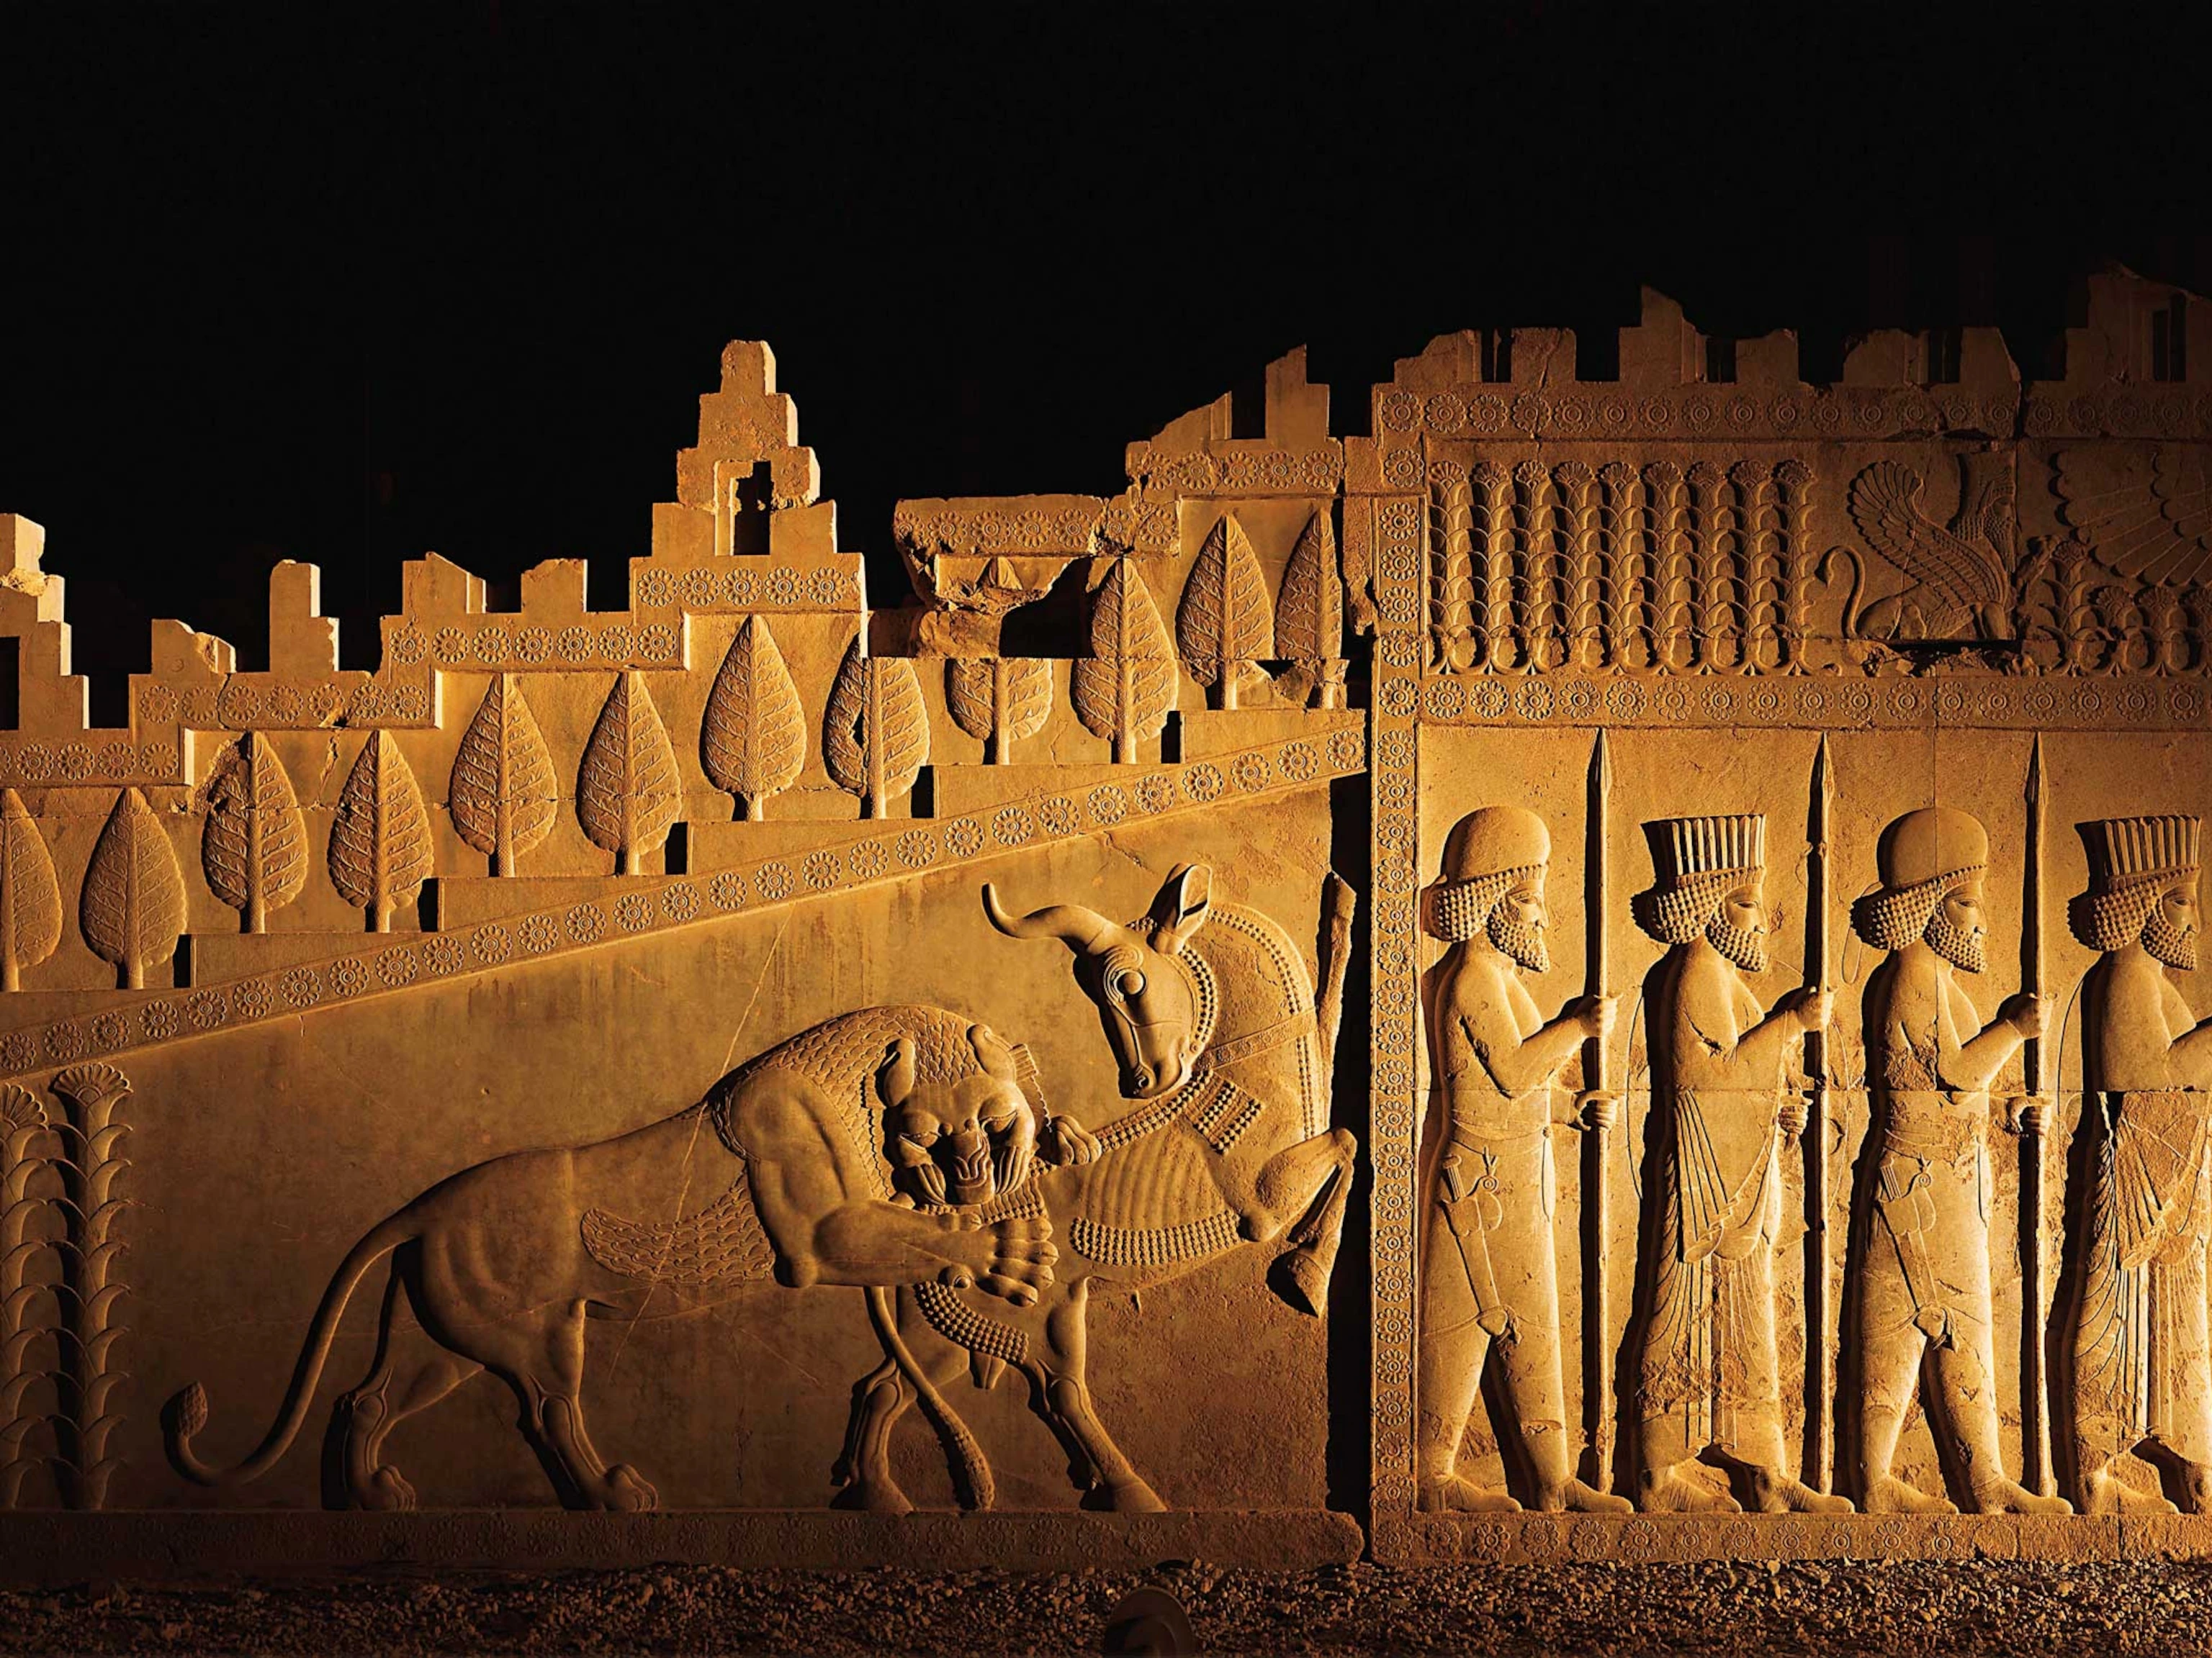
Nowruz is a time for family and friends to gather and celebrate the end of one year and the beginning of the next
Children have a fourteen-day vacation from school, and most adults do not work during the Nowruz festivities
Throughout the holiday period friends and family gather at each other’s houses for meals and conversation
Nowruz
Celebrations

